Slide 1
Design Patterns Overview

Slide 2
Learning Objectives
By the end of this week, students will be able to:
Understand the purpose and benefits of using design patterns in PHP
Identify and describe common design patterns (e.g., Singleton, Factory, MVC)
Apply appropriate design patterns to solve common coding problems in PHP
Notes:
Understand the purpose and benefits of using design patterns in PHP
Identify and describe common design patterns (e.g., Singleton, Factory, MVC)
Apply appropriate design patterns to solve common coding problems in PHP

Slide 3
Introduction to Design Patterns
- refers to a reusable solution that can be used as a template for developing applications to address commonly occurring problems. You can consider the software design patterns as formalized best practices when developing software solutions.

Slide 4
Common Design Patterns
1. Singleton
-patterns useful when you want to restrict the instantiation of an object of a certain class to only one instance. The name "singleton pattern" comes from the concept of singleton in Mathematics. Singleton pattern ensures that there will be only one instance, having a global access to it throughout the application.
2. Factory
-one of the most commonly used design patterns. In this pattern, you dont declare the object of the desired class directly, but another class is provided whose static method creates the required object.
3. Strategy
-recommends an approach where you encapsulate specific families of algorithms allowing the client class responsible for instantiating a particular algorithm. The class that implements the pattern has no knowledge of the actual implementation.
Notes:
Yes, exactly!
When a method or property is declared **static**, you access it using the **ClassName::method()** or **ClassName::$property** without creating an object.
✅ Syntax Overview
php
ClassName::staticMethod(); ClassName::$staticProperty;
🔧 Example: Static Method
class Helper { public static function greet($name) { return "Hello, $name!"; } } // ✅ No need to create an object echo Helper::greet("Jerico"); // Output: Hello, Jerico!

Slide 5
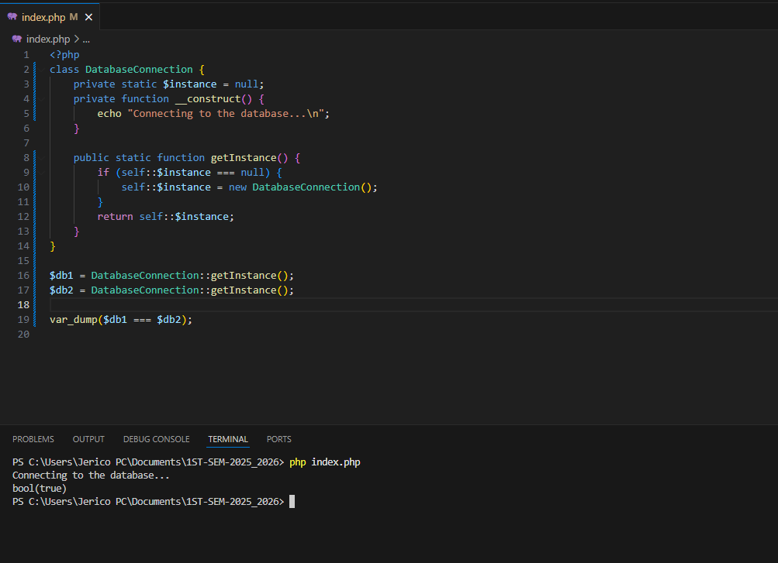
Implementing Patterns in PHP
1. Singleton
Notes:
✅ What's Happening in Your Code:
$db1 = DatabaseConnection::getInstance(); $db2 = DatabaseConnection::getInstance();
You are calling getInstance() twice, but...
Inside that method:
if (self::$instance === null) { self::$instance = new DatabaseConnection(); }
...it checks if an instance already exists.
✅ If no instance, it creates one (new DatabaseConnection()).
✅ If an instance already exists, it just returns that same object.
Confirm It:
var_dump($db1 === $db2);
This checks if $db1 and $db2 point to the same object in memory.
Output: bool(true) — means same instance.
So to be clear:
You're not creating two different instances.
You're creating two variables that point to the same single instance.

Slide 6
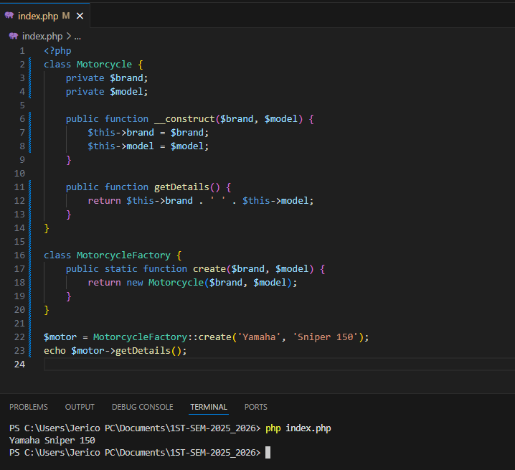
Implementing Patterns in PHP
2. Factory

Slide 7
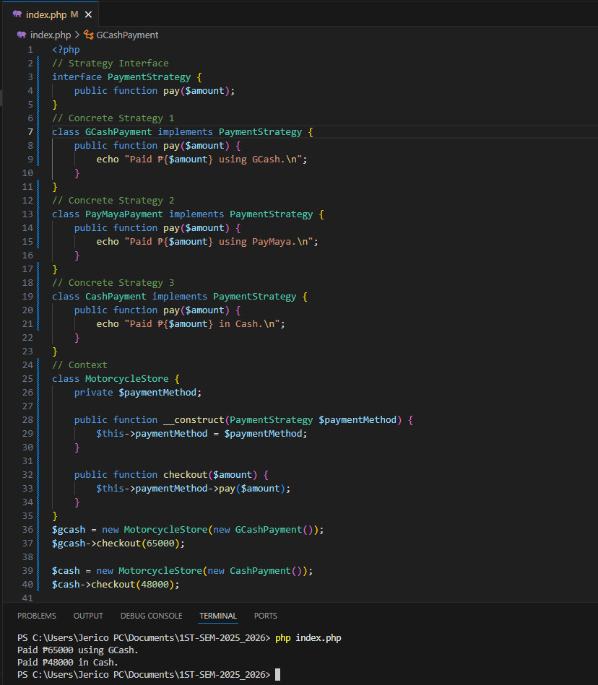
Implementing Patterns in PHP
3. Strategy

Slide 8
Implementing Patterns in PHP
2. MVC Design Pattern which stands for Model, View and Controller, is a very popular softeware architecture pattern. Most of the PHP Framework such as Laravel, Symfony etc. implement the MVC architecture.
Model − Refers to the data structure. In this case, the database.
View − Refers to the user interface. The HTML and CSS.
Controller − The "middleman" doing the processing. Accepts input from the view, and works with the model.

Slide 9
Thank You
https://www.tutorialspoint.com/php/php_design_patterns.htm

